Slide 1
Machine Learning is improving exponentially
2023 ?
2022
DALL-E2
MakeAVideo
WebGPT
Minerva
Adept
2021
– Codex
– AlphaFold
2020 – GPT-3
2018 – BERT
2017 – Transformer Language Models
2016 – AlphaGo
2015 – Microsoft beats AlexNet
2012 - AlexNet wins ImageNet
1997 - Deep Blue
1997
12
17
2022
Notes:
The story of large language model starts with machine learning.
Obviously machine learning has been a research topic since well before the 90s but the biggest headline everyone here probably remembers is when deep blue beat the grandmaster Kasparov at chess back in 1997. Since then progress has been improving at an exponential rate. That makes it hard for our linear brains to predict how much is going to change over the next year.
For example it was another 14 years before we had a real working neural net. But then just four years after that it achieved human level proficiency at being able to label images.
A year after that the machine could beat experts in the game of go with no training data at all then a year after that you'll hear the word transformer used a lot because it started out as a way of doing human level text translation but it created the foundation of all the modern language models. Google came out with Bert in 2018. One way we measure the size of these language models is by how many parameters they reason over. Bert had 340 million. Two years later open AI's GPT 3 came out with 175 billion params, three orders of magnitude larger size. If you think of each param as a neuron, that’s also twice as many neurons as the human brain. As such it was one of the first to be called a large language model. I'll talk on the next slide about all the breakthroughs that came from that. GPD three was trained to write text but it turned out it was pretty good at writing code 2. So open AI fine-tuned that model with more training data from GitHub to create codecs which is the brains behind GitHub copilot that writes code for you. The ideas of these large language models were then applied to non language problems like alpha fold being able to solve one of the hardest bio engineering problems of how to fold proteins. and the breakthroughs continue. If it takes $12 million to do a single training run then you need other ways to keep it up to date with the latest news and API sets and so on. WebGPT is a way of doing that. And now we're starting to see breakthroughs in machines being able to explain themselves and show their reasoning to solve complex math problems.
I don't know what will show up next year but I expect it will be a step function improvement. ----
1997 Deep blue: Beats GM Kasparov at chess 2011 ImageNet first release: First real success of neural nets 2015 ImageNet: Human-level image recognition 2016 AlphaGo: Beats humans at Go with no training data 2017 Transformer language models: Human-level text translation
2018 BERT: Language model w/ 340 million params (BooksCorpus+Wikipedia)
2020 GPT-3: Large language model w/ 175 billion params (training run costs $12M!)
2021 Codex: Fine-tuned large language model to output code
2021 AlphaFold: Beats humans at protein folding 2022 DALL-E2: Human-level image generation (also Stable Diffusion) 2022 WebGPT: Human-level synthesizing answers from the web
2022 Minerva: Solves math problems with reasoning showing "chain of thought"
2023 ?

Slide 2
Large Language Models redux
Ned Friend
Jason Wolfe
Oct 2022 (See speaker notes for a full version of the talk track)
Recording

Slide 3
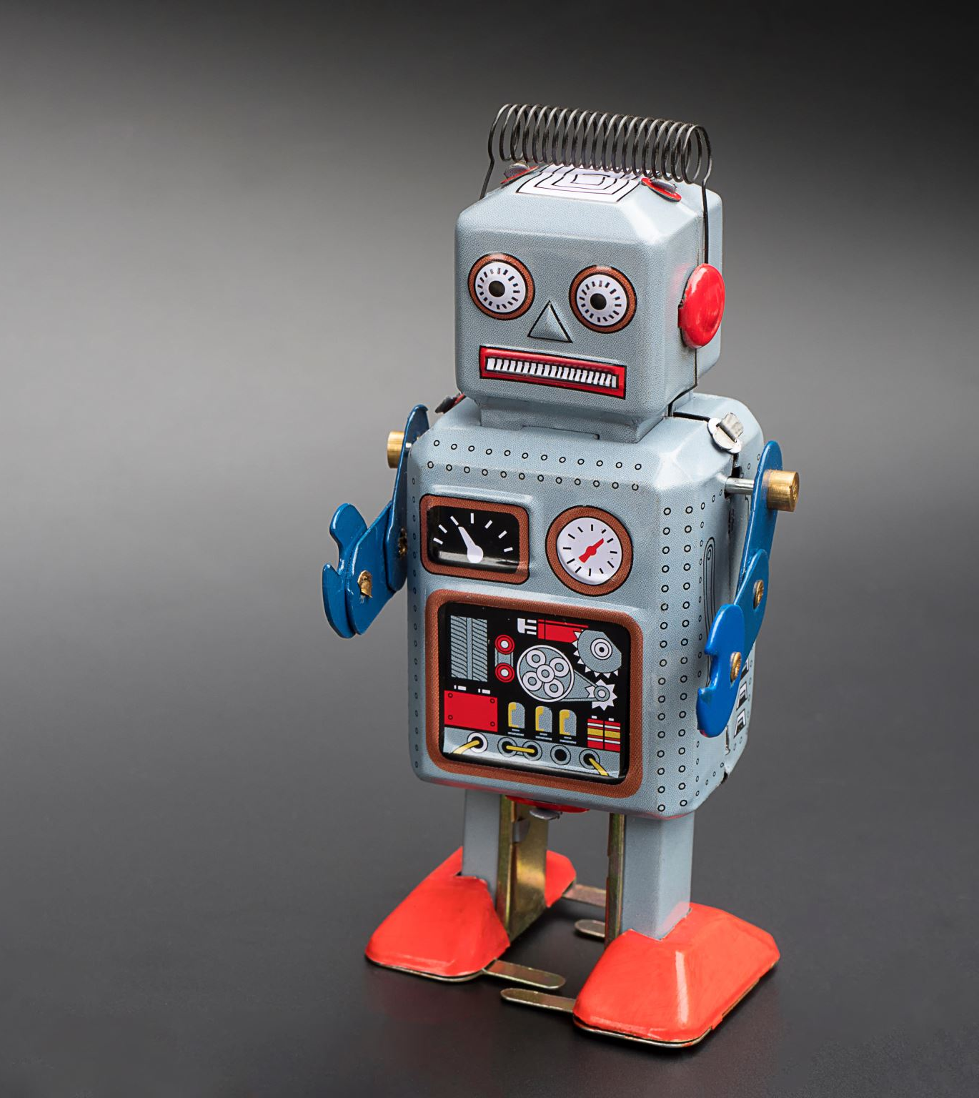
Large Language Models (LLMs)
Model: Machine Learned of the form input2output
Language: nl2nl
Large: More data than can be labeled (growing 10x/year!)
"Few-shot" learning through prompts, not training
Foundational Model to train smaller lower COGs models
Notes:
So one of the biggest things that's emerging from this machine learning exponential progress is what we called large language models.
They're called models because they're probabilistic machine learning systems that predicts output given some input. They model the world using some sample observations of what the world does. For example, imagenet was trained on pairs of labeled pictures, where it was given the pictures and predicts the labels. Some of this training data came from publicly labeled photos, some of it now comes from the picture Captcha's we all do. Language models are models that take in text and output more text. Word prediction, text translation, and so on are all language models. They're called large, because they train on more data than you can imagine. Notably, it's more data than can be labeled with more parameters than can be hand-tuned by a data scientist, so they learn things we can't predict.
One big emergence from these large models is "in-context" or "few-shot" learning with GPT-3. Before that, if you wanted a model to solve a new task, you always had to collect a big dataset and train a new model. Now you can just write some text with a few examples and often achieve state-of-the-art (or at least near it) performance, beating older-school models that were trained specifically on larger task-specific datasets. This really changes the game in terms of democratizing and opening the space of what's possible. It's truly "emergent" in that you don't see the ability to do this until your model is roughly GPT-3 sized.

Slide 4
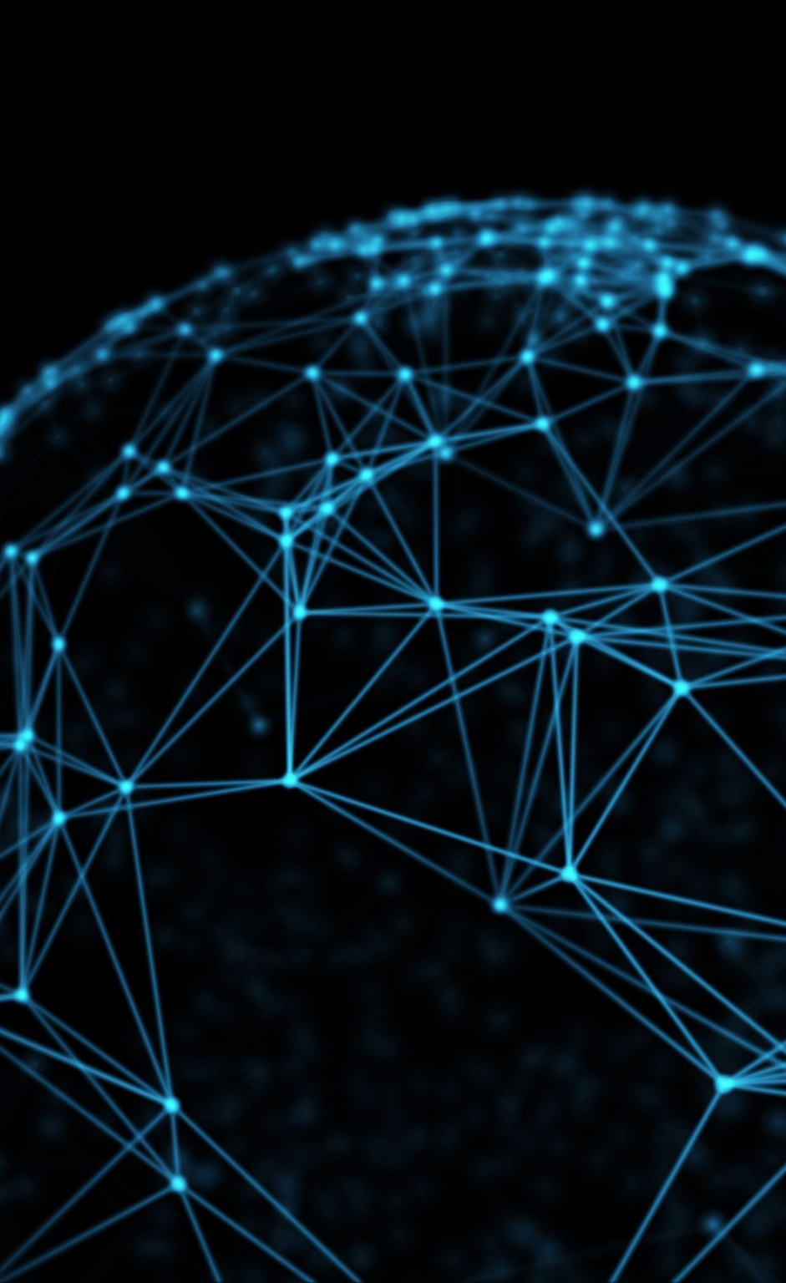
LLM demo videos
GPT3.5: nl2nl (Foundry playground, demos, Babel, ethics)
DALLE: nl2image
MakeAVideo: nl2video (and image2video, by Meta)
Codex: nl2code (Github Copilot)
Flow: nl2code in PowerAutomate
Outlook: nl2action using SM Harbor
Excel (Duka Walla): nl2action using SM Harbor
M365 Graph: nl2action using SM Harbor
Adept’s ACT-1: nl2action for any UX
AI for Hire: nl2action vision for interpersonal orchestration
Notes:
So to make this real I figured we'd spend most of my presentation just looking at examples.
Some of you may already have access to this GPT3 playground where I'll show you a couple of its built-in examples and we can type some of our own.
You all should also have access to this DALL-E playground. Let's type in an example just to see how it works.
Meta recently shipped the logical next step: make videos, not just static images.
As I mentioned large language models don't just write text they can also write code because code is just text. The home screen for the GitHub copilot shows an example of that.
Semantic machines used machine learned models to write text before it was cool. That's how we built the outlook voice assistance.
We've now combined that platform with the latest large language models to accelerate expanding to other domains like this three second demo of excel. And this 30 second demo of the M365 graph. We’re not the only ones trying to do this. Adept created ACT-1, a large-scale Transformer trained to use digital tools through their UX, which they’ve taught to use a web browser. Its Chrome extension observes what’s happening in the browser and takes certain actions, like clicking, typing, and scrolling, etc. The observation is a custom “rendering” of the browser viewport that’s meant to generalize across websites, and the action space is the UI elements available on the page.​
​
John Harris his team is also designing experiences like this to imagine what it would look like for large language model to write out entire plans of actions.

Slide 5
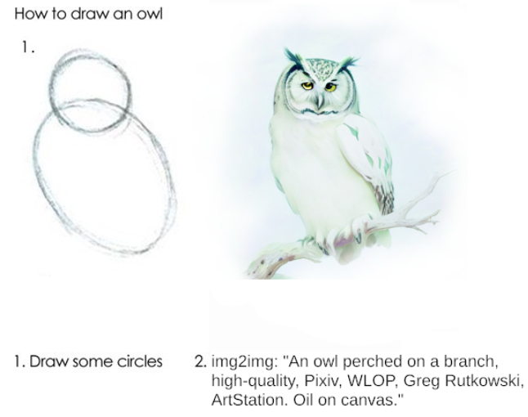
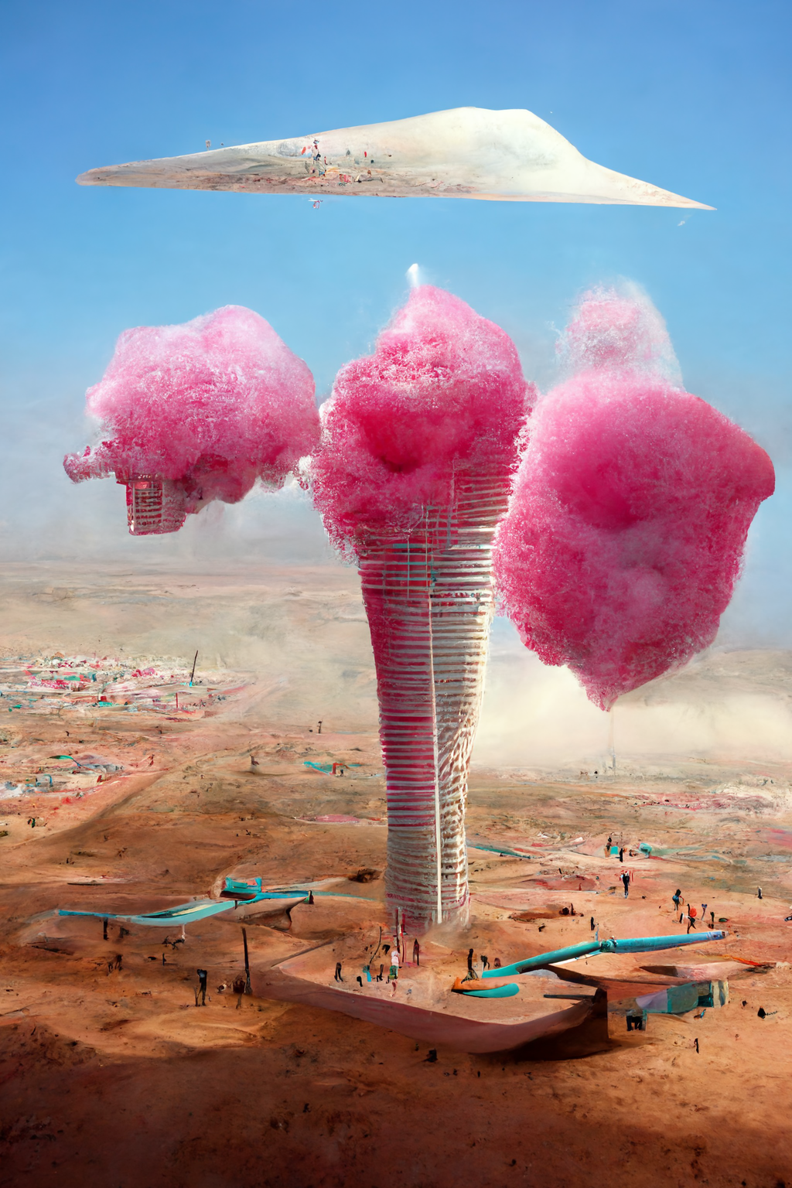
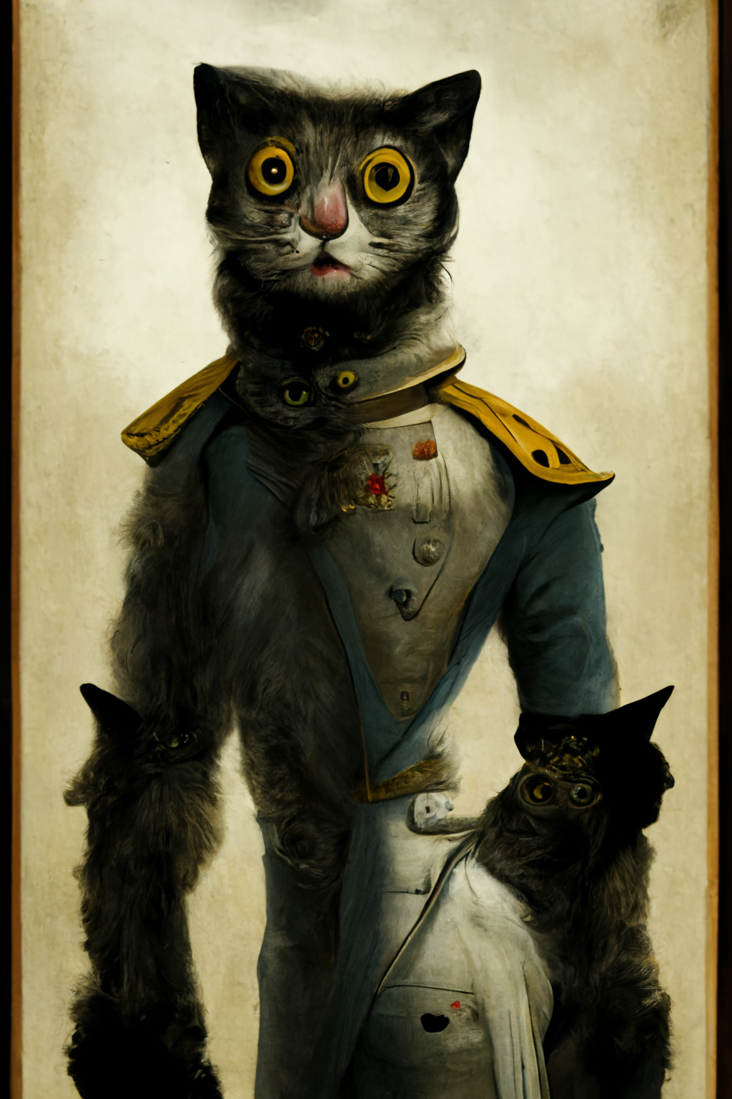
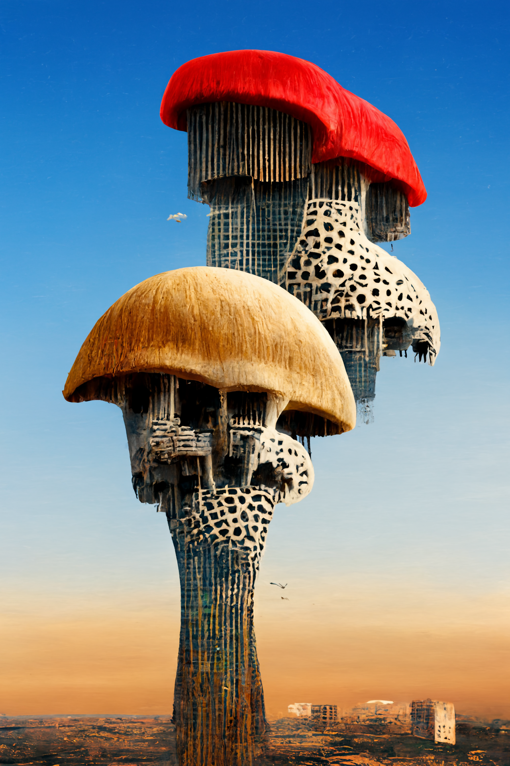

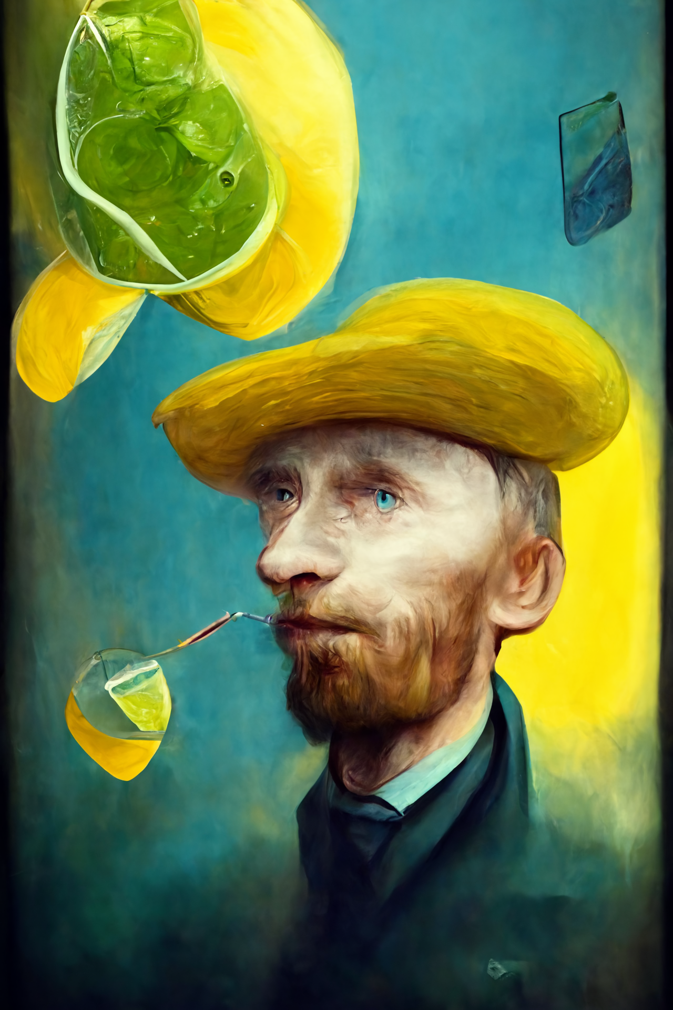
nl2image Examples
Stable Diffusion, MidJourney, Playing with DALL·E 2
Lensa
Notes:
Since the prompt is the hard part to get right, I wanted to show a few examples of the kinds of images models can create.

Slide 6

Chain of Thought and nl2code Examples
Question: Assume that the variance of the first n natural is 10, and the variance of the first m even natural numbers is 16.
Compute m + n.
Model output: Let σ² be the variance of the first m even natural numbers, and $τ2$ be the variance of the first n natural numbers. Then, we have $τ^{2}= \frac{n^{2}−1}{12}$ and $σ^{2}= \frac{m^{2}}{3}$. We solve the systems of equations:
$$\frac{n^{2}−1}{12}=10$$
$$\frac{m^{2}−1}{3}=16$$
This translates into the system
$$n^{2}=121$$
$$m^{2}=48+1=49$$
Therefore, n = 11 and m =7, so n + m = 18
Question: What is Bill Gates's age, in hours?
[DEBUG] Generated Code:
import datetime
now = datetime.datetime.now( }
gates_birthday = datetime.datetime(1955, 10, 28)
gates_age_in_hours = (now - gates_birthday).total_seconds() / 3600
print(gates_age_in_hours)
Answer: 586241.3784563539
Question: What is MSFT trading at?
[DEBUG] Generated Code:
import requests
url = f"https://query1.finance.yahoo.com/v7/finance/quote?symbols=MSFT"
response = requests.get(url, headers={'USER-AGENT': "Mozilla/5.0"})
price = response.json( )["quoteResponse"]["result"][@]["regularMarketPrice"J
print(price)
Answer: 241.07
Minerva
Sergey Karayev on Twitter (adapted)
Notes:
I also wanted to show that large language models don't just autocomplete code they can also solve math problems and write code on demand.

Slide 7


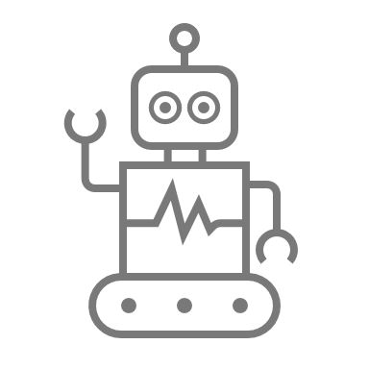
Models require human oversight
nl2text
nl2code
nl2action
User in the loop
Developer in the loop
nl2code
+ executeCode()
– developer
Implicit Oversight
User In The Loop through SM Harbor with UX integration (Using LLMs for Action)
Notes:
When people see that large language models can write code they get excited about it just automatically automating everything. The problem is that as semantic machines has learned over the last five plus years, they can very easily write the wrong code. For example left to its own devices the code rarely compiles as is sometimes from syntax errors sometimes from hallucinating APIs. Even if it compiles it's often not what the user would expect or exactly what they want. For example it might call the Gmail API's simply because those are the most commonly found examples on the web when in our case we might want them to use outlook API's. And of course it can do destructive things like e-mail the wrong Rajesh your apology for screwing up. Or accidentally cancel the wrong meeting with a CVP.
In short models are probabilistic and as such responsible AI requires that we put the user in control before the AI does anything permanent.
Models that just output text have the user in the loop because any user can read text. Models that output code are in the context where the user is a developer so the developer can read and debug that code. Models that output actions are like the models that output code but then they execute the code without a developer in the loop. That's a recipe for dystopian science fiction. We do not want the machines out of our control. That's why semantic machines built a platform that not only gets the large language models to write the right code but also creates a client side experience that lets the user intervene before it does anything permanent. In particular it makes it easy for people to correct mistakes using the existing UX and gives the user final say before sending anything to another person. Unlike almost anything else you do on a computer people don't have an undo button.

Slide 8
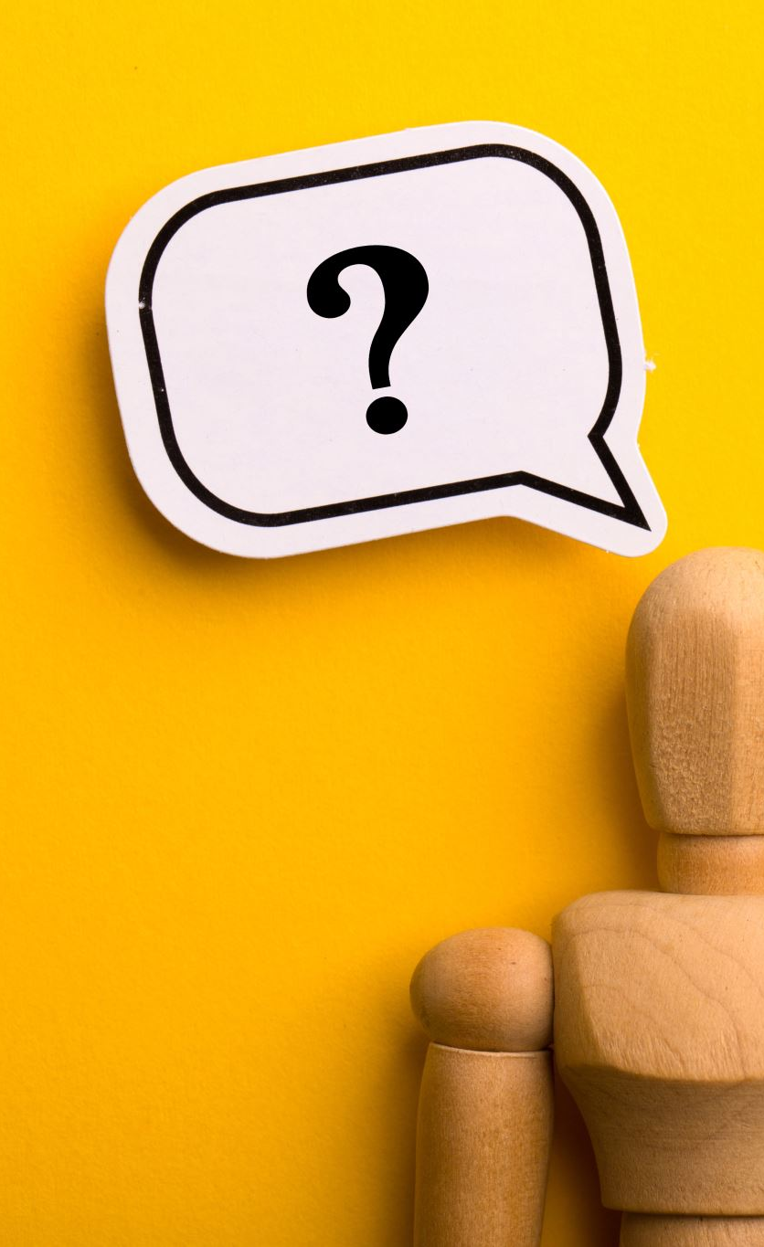
Discussion
What text could a machine write for your users?
What actions could a machine do for your users?
What other input2output data sets could machines train on to automate those transformations?
How do we address the ethical and societal implications? (See ethics & society)
Notes:
With that primer, let's discuss how your projects could use large language models or their corollaries like predicting actions?

Slide 9
MAGE: LLM-like Foundation Model for Actions (actions2action)

